Slide 1
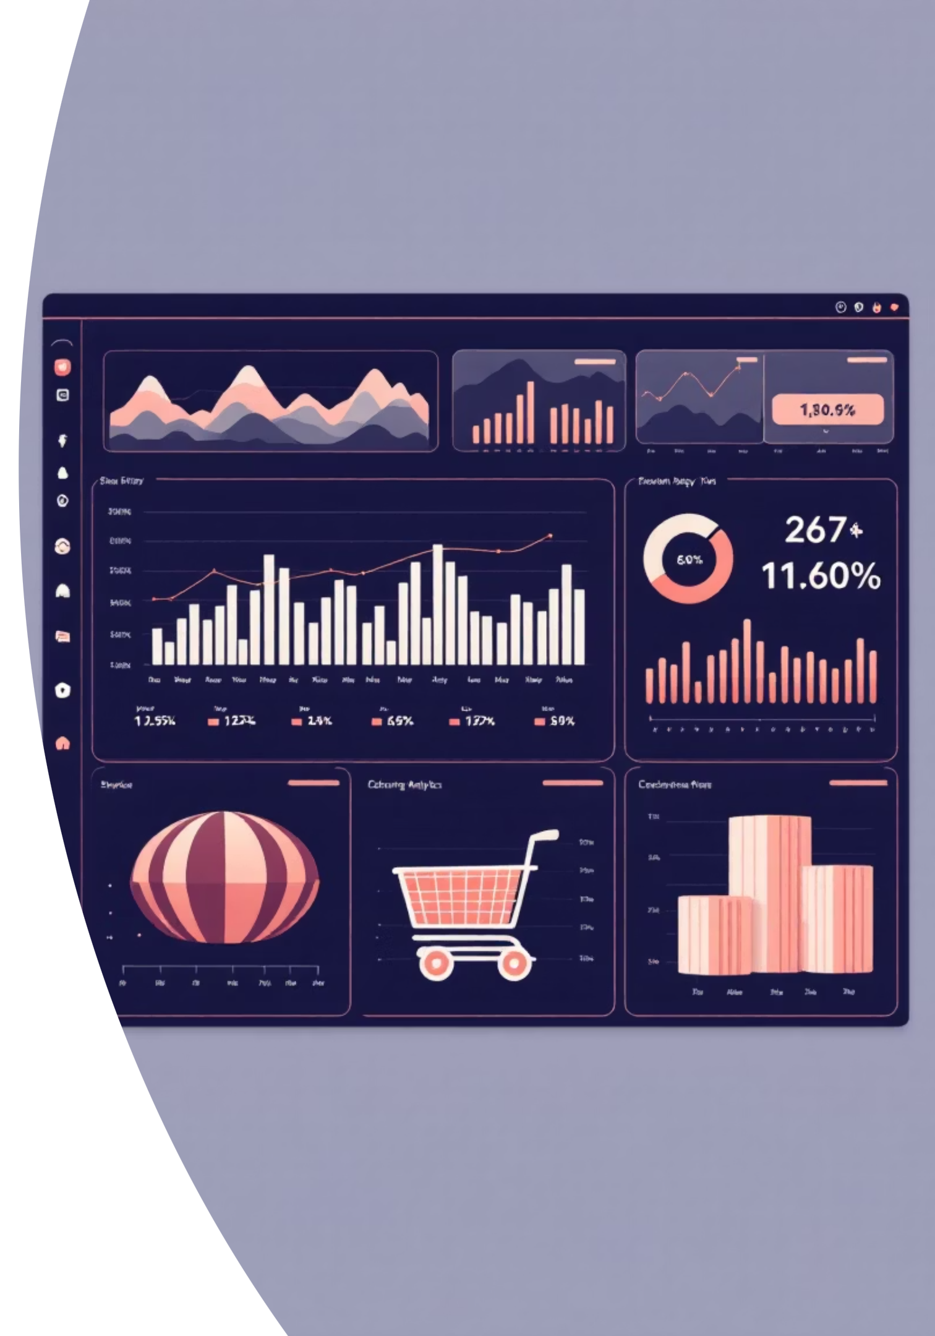
Customer Shopping Behavior Analysis
Uncovering insights from 3,900 purchases to guide strategic business decisions through data-driven analysis of spending patterns, customer segments, and product preferences.

Slide 2
Dataset Overview
3,900
18
Key Features Tracked
Customer demographics and subscription status
Total Purchases
Data Points
Purchase details including category, amount, and season
Transactions analyzed across all categories
Features tracking customer behavior
Shopping behavior patterns and review ratings
Shipping preferences and discount usage
50
Locations
Geographic distribution of customers

Slide 3

Data Preparation & Cleaning
01
02
Data Loading
Missing Data Handling
Imported dataset using pandas and performed initial exploration with summary statistics
Imputed 37 missing Review Rating values using median rating by product category
03
04
Feature Engineering
Database Integration
Created age_group and purchase_frequency_days columns for deeper analysis
Connected to PostgreSQL and loaded cleaned data for SQL analysis

Slide 4
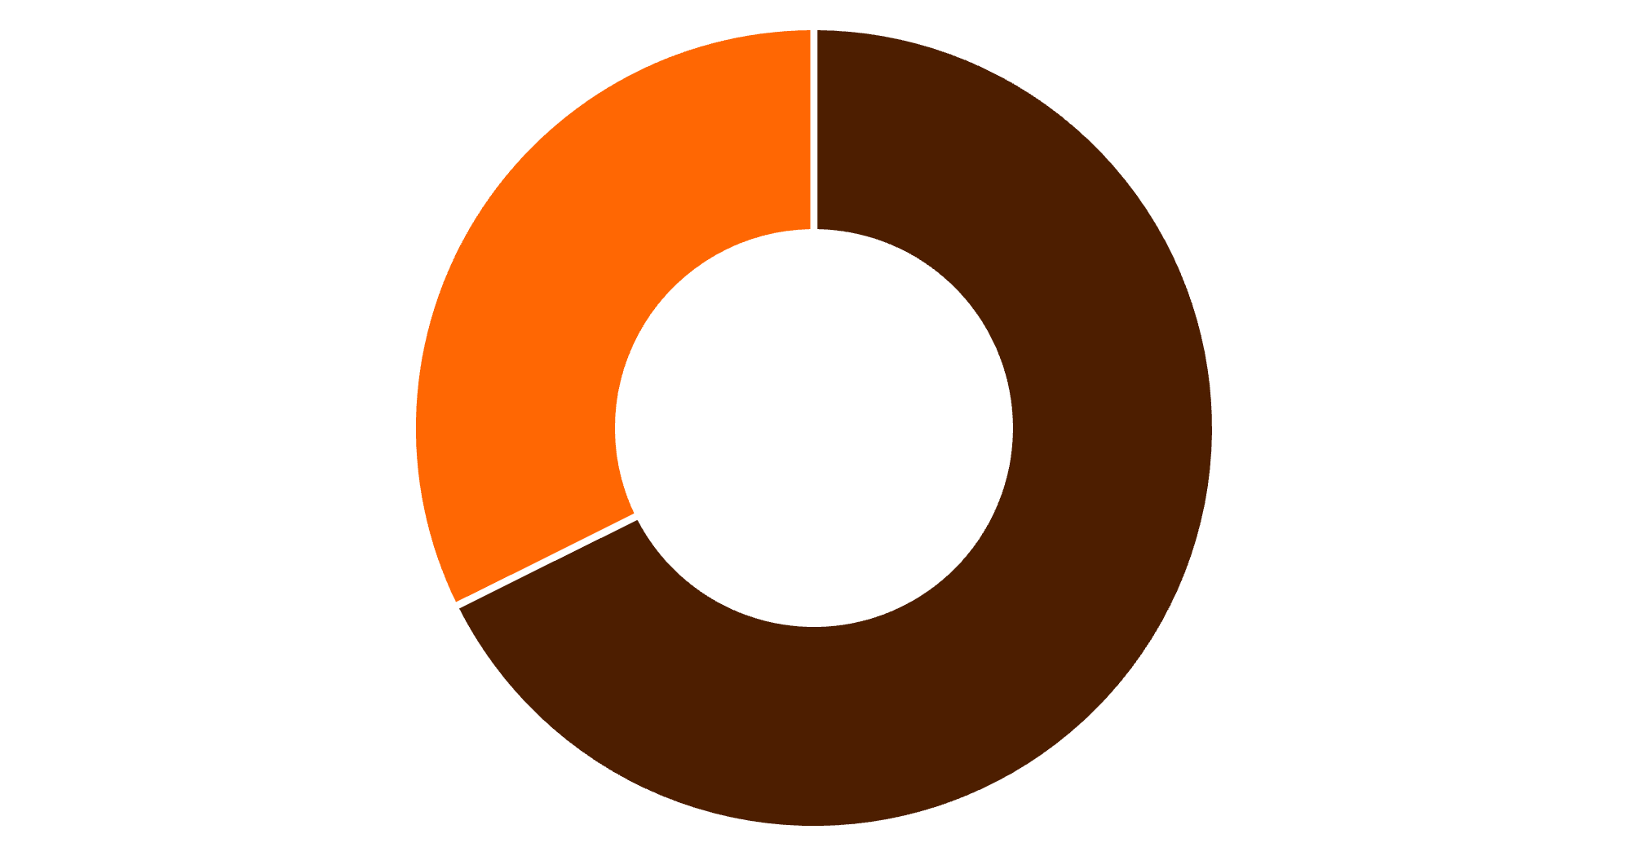
Revenue Insights by Gender
Key Finding
Male customers generate 68% of total revenue, significantly outpacing female customers. This presents opportunities for targeted marketing strategies.
Male
Female

Slide 5
Top-Rated Products
1
2
3
Gloves
Sandals
Boots
Average Rating: 3.86
Average Rating: 3.84
Average Rating: 3.82
4
5
Hat
Skirt
Average Rating: 3.80
Average Rating: 3.78
These top-rated products should be highlighted in marketing campaigns and featured prominently in product positioning strategies.

Slide 6

Customer Segmentation Analysis
Loyal Customers
Returning Customers
New Customers
3,116 customers
701 customers
83 customers
The largest segment with consistent purchase history
Engaged buyers showing repeat behavior
Fresh opportunities for conversion
Strategic Opportunity
Focus on moving Returning customers into the Loyal segment through targeted loyalty programs and personalized engagement.

Slide 7
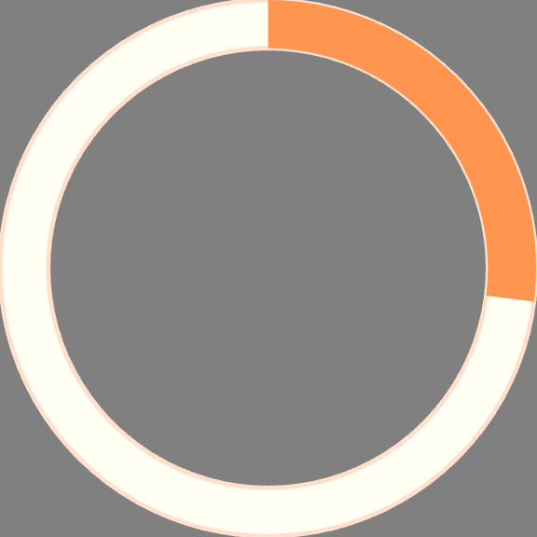


Subscription Status Comparison
Revenue Analysis
Subscribers: $62,645 total revenue, $59.49 average spend
Non-subscribers: $170,436 total revenue, $59.87 average spend
27%
Insight: Despite similar average spend, the large non-subscriber base represents significant untapped potential for subscription conversion.
Subscribers
1,053 customers
73%
Non-Subscribers
2,847 customers

Slide 8
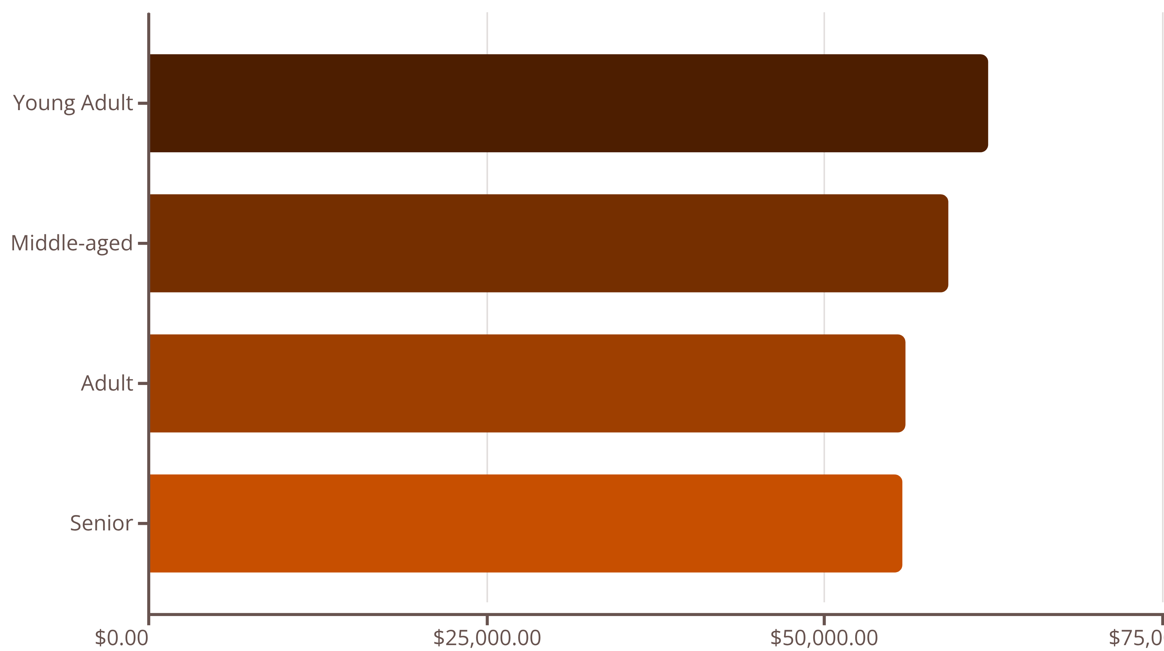
Revenue by Age Group
Young Adults lead revenue generation, followed closely by Middle-aged customers. Revenue distribution is relatively balanced across age groups, suggesting broad market appeal.

Slide 9
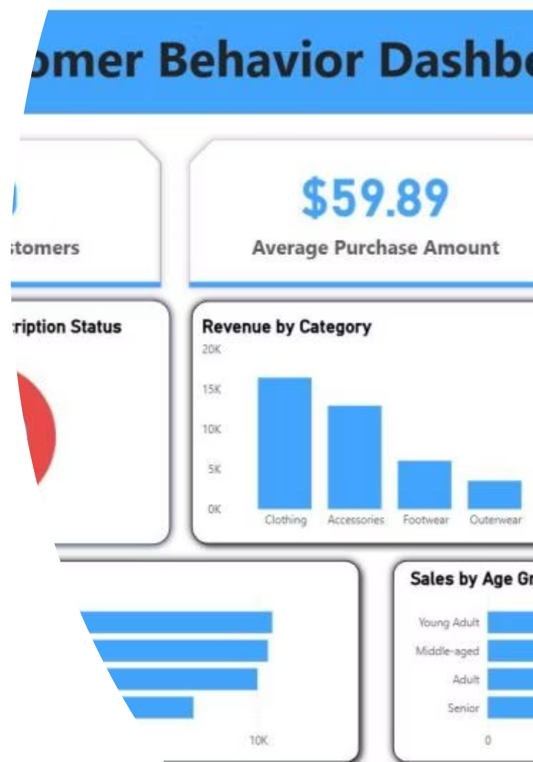
Interactive Dashboard
Key Metrics
Category Performance
Shipping Insights
650 customers analyzed
Clothing leads in both revenue and sales volume across all categories
Express shipping users show $60.48 average spend vs $58.46 for standard
$59.89 avg purchase
3.71 avg rating

Slide 10

Strategic Recommendations
Boost Subscriptions
Loyalty Programs
Review Discount Policy
Promote exclusive benefits to convert the 73% non-subscriber base into recurring revenue
Reward repeat buyers to move 701 returning customers into the loyal segment
Balance sales boosts with margin control—839 customers used discounts above average spend
Product Positioning
Targeted Marketing
Highlight top-rated products like Gloves and Sandals in marketing campaigns
Focus on high-revenue Young Adults and express-shipping users for maximum ROI

